Slide 1
An Exploration into Pokemon Data
Payne Moser
DSC 101
Final Presentation
Pledged

Slide 2
What I Hoped to Accomplish
When I originally decided to do an exploration into Pokemon data, I had big ideas as to how I wanted to explore the data. At first I wanted to see how stat totals affected online gameplay, but then I realized that there were too many variables and an exploration into the gameplay mechanics would be above my skill set. I soon adjusted my hypothesis to seek out which generation on average has the strongest pokemon, what type has the strongest pokemon, and also how does stat totals affect a pokemons legendary status?
Notes:
Note that strength will be measured by stat total
Stat total is the factors that determine how well a pokemon will perform in battle.
The factors are HP, SA, PA, SD, PD, and Speed.

Slide 3
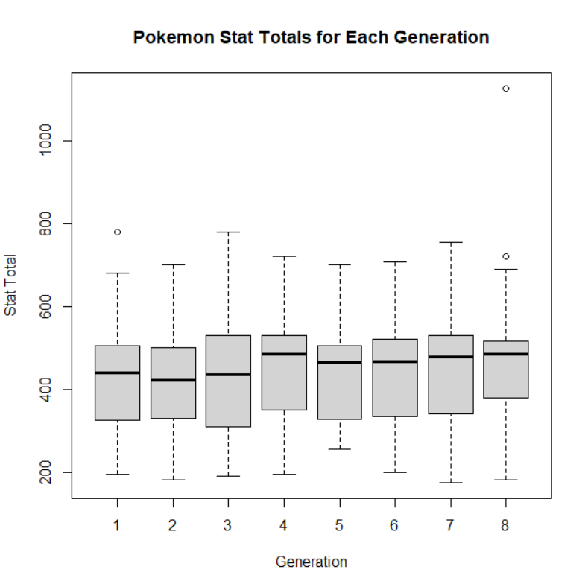
Which Generation Had the Highest
Stat Total
Using R I created a boxplot to show the stat totals for each generation of pokemon. I found that with each generation there is not one that is significantly stronger than the others. Generation 4 only has slightly higher stat totals.

Slide 4
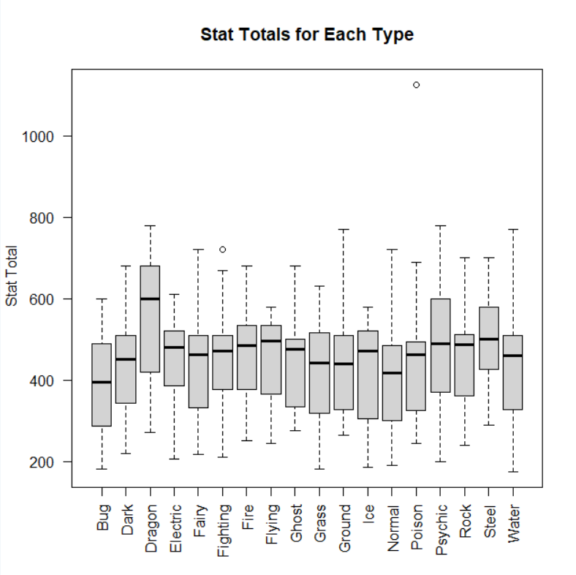
Which Type Has the Highest
Stat Total?
When trying to find which type had the highest stat totals I found that the majority of the types did not have an advantage in total stats. The one outlier in this category was the dragon typing which tends to have significantly higher stat totals.
Notes:
Explain pokemon Typing

Slide 5
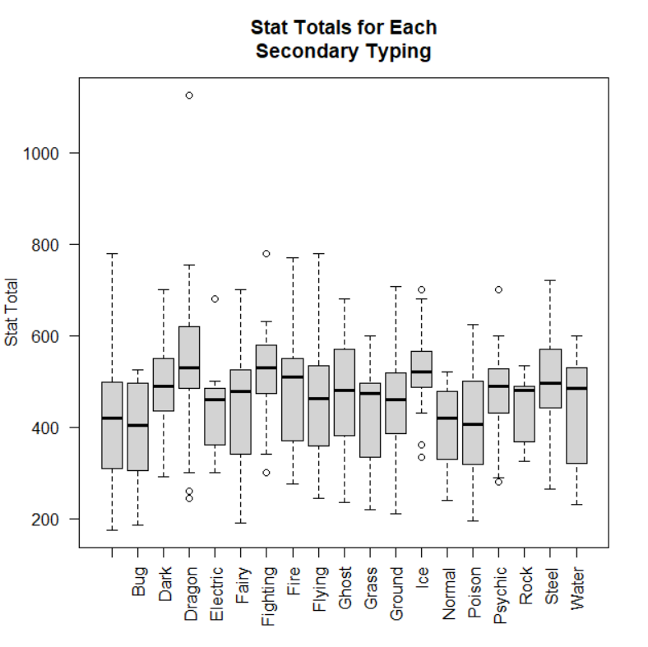
Which Type Has the Highest
Stat Total?
There are many pokemon that have a second typing. When I made a boxplot for the secondary typing the results were much more diverse, yet the dragon typing is still above the majority of other types stat totals. The ice type also has high stat totals.
Notes:
Also note that pokemon without a secondary typing are on the lower end of stat totals.

Slide 6
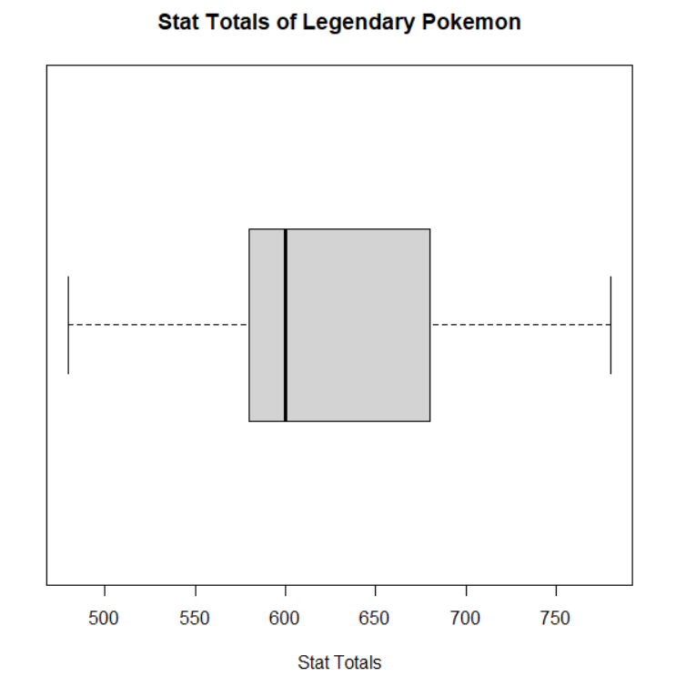
How Legendary Status
effects Stat Totals
From the boxplot that I created for the stat totals of all legendary pokemon, you can see that the average stat total is 600 and that most legendaries stat totals fall somewhere between approximately 575 and 675.

Slide 7
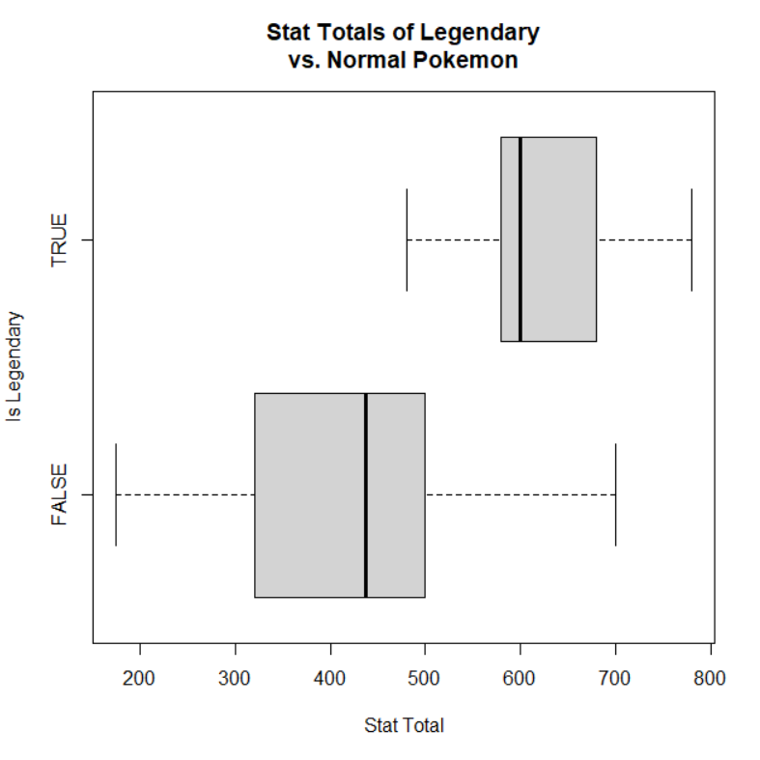
How Legendary Status
effects Stat Totals
When comparing the boxplot of the legendary stat total to the boxplot of all normal pokemons stat total, you see that legendary pokemon are significantly stronger than your average pokemon.

Slide 8
Limitations:
My original plans for this EDA included an exploration into the stats of pokemon and how they affect a pokemon's battle ability. The main problem with doing this would be that the gameplay mechanics for pokemon are ever-changing with the introduction of each new generation. Another issue that I found was there was a few errors in the dataset; many of these were easily fixable and did not affect my project, it was just human error that I had to work around.

Slide 9
Summary:
Through my research and putting my data in different types of graphs in R, I was able to come to many conclusions to my hypothesis questions. When trying to find which generation had the strongest pokemon, I found that the majority of the generations of pokemon had extremely similar stat totals. Though they were all similar, I found that generation 4 on average had the strongest pokemon. When I was looking into what type had the strongest pokemon it was obvious in both the primary and secondary typing graphs that Dragon type had the strongest pokemon. When examining the graphs I made for all of the legendary pokemon I was not able to find any information as to how a pokemon becomes legendary, just that legendary pokemon are significantly stronger than normal pokemon.

Slide 10
Citations:
Data Society. (2020). Pokemon With Stats. [CSV]. Retrieved from https://data.world/
R Core Team (2021). R: A language and environment for statistical
computing. R Foundation for Statistical Computing, Vienna, Austria.
URL https://www.R-project.org/.

